Slide 1
INTELLECTUAL PROPERTY in ONLINE JOURNALISM
GRACE KIM
DENNIS HOWE

Slide 2
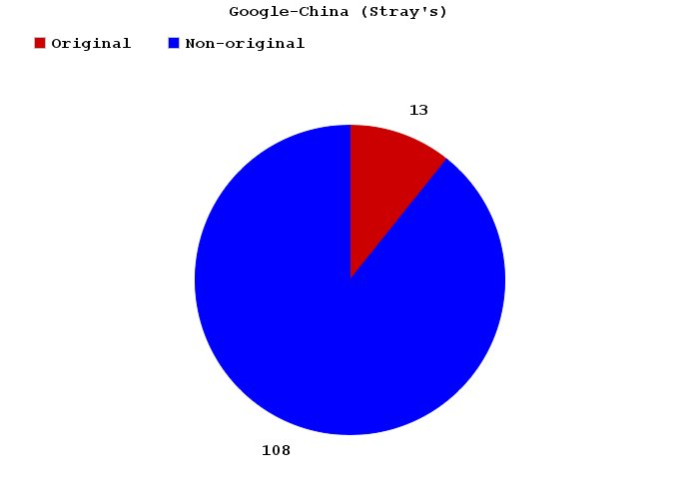
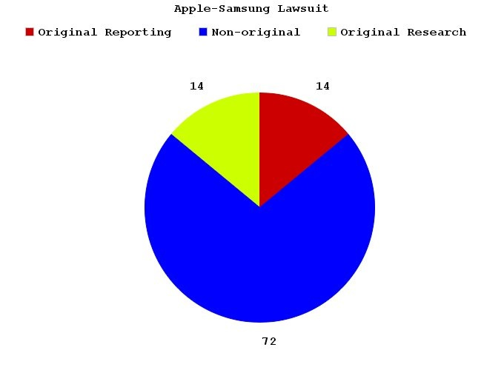
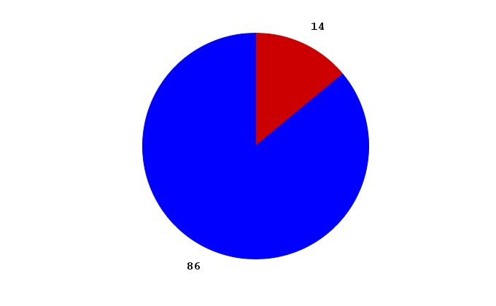
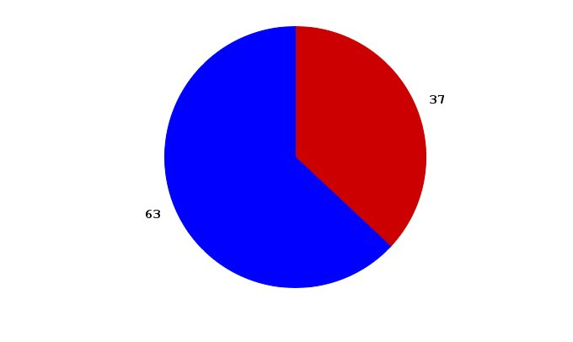
WHO DOES ORIGINAL REPORTING?
Google-China Hackers
(Stray’s)
Social Media-
Egyptian Revolution
Apple-Samsung Lawsuit
2

Slide 3
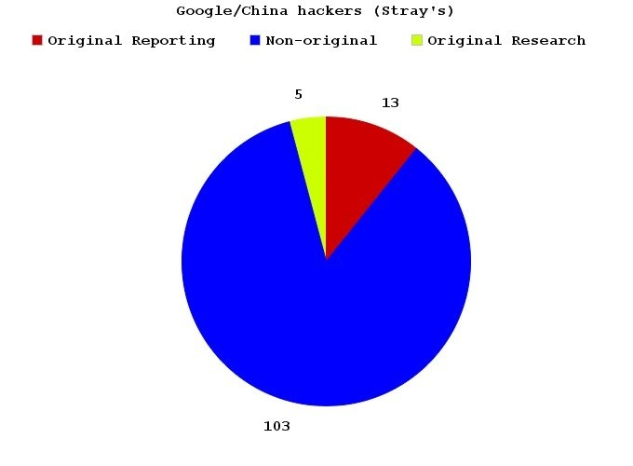
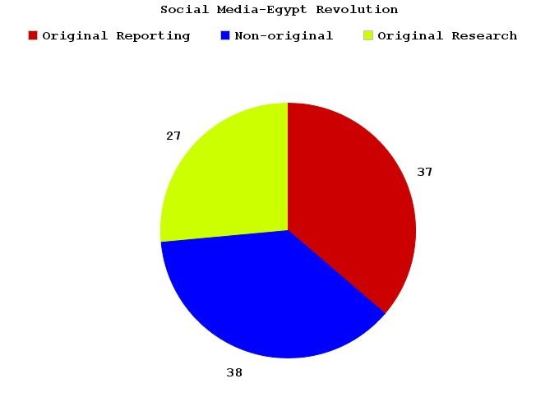
WHO DOES ORIGINAL
ANYTHING?
Google-China Hackers
(Stray’s)
Apple-Samsung Lawsuit
Social Media-
Egyptian Revolution
3

Slide 4
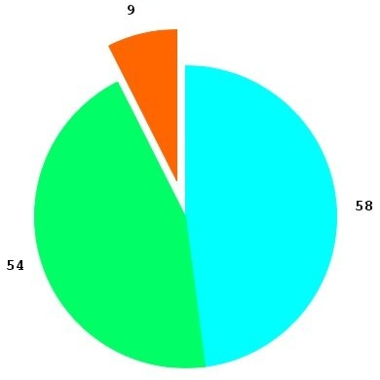
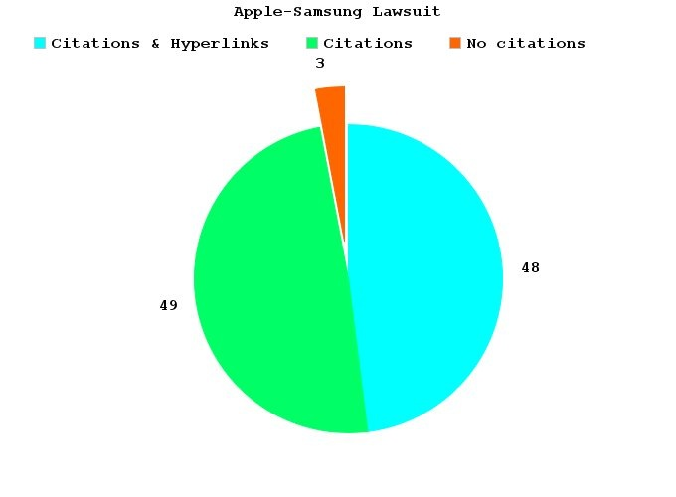
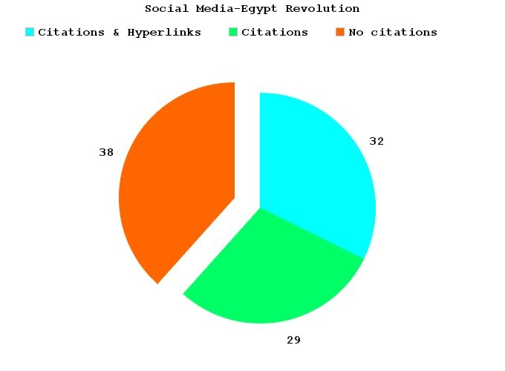
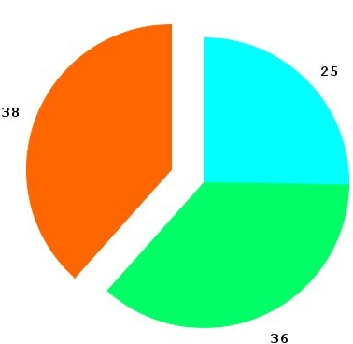
WHO CITES?
Google-China Hackers
(Stray’s)
Social Media-
Egyptian Revolution
Apple-Samsung Lawsuit
4

Slide 5
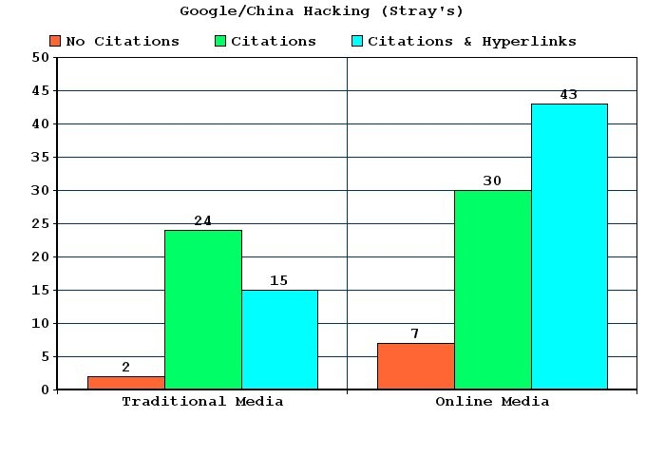
WHO CITES:
THE BREAKDOWN
5

Slide 6
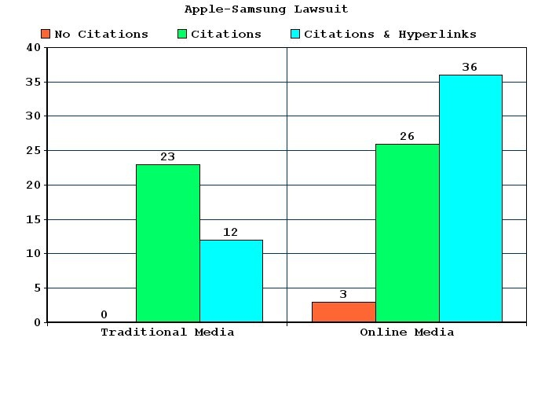
WHO CITES:
THE BREAKDOWN
6

Slide 7
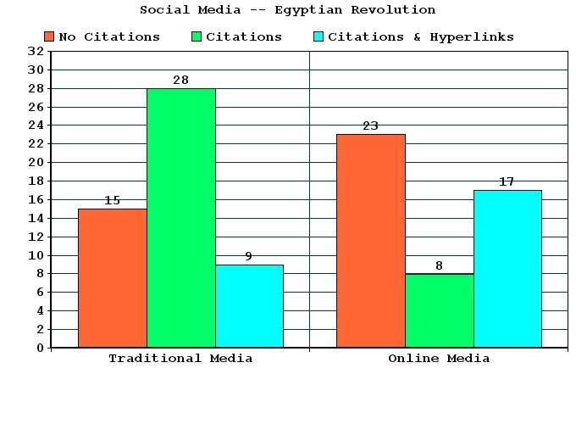
WHO CITES:
THE BREAKDOWN
7

Slide 8
WHO CITES WHO?
8

Slide 9
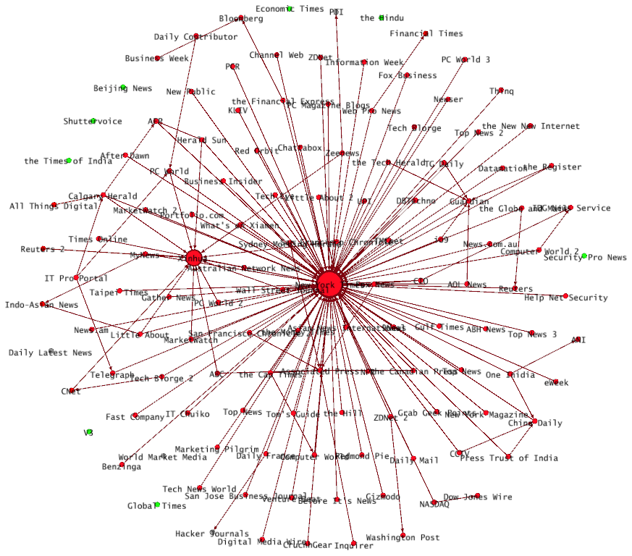
GOOGLE/CHINA HACKERS (STRAY’S)
9

Slide 10
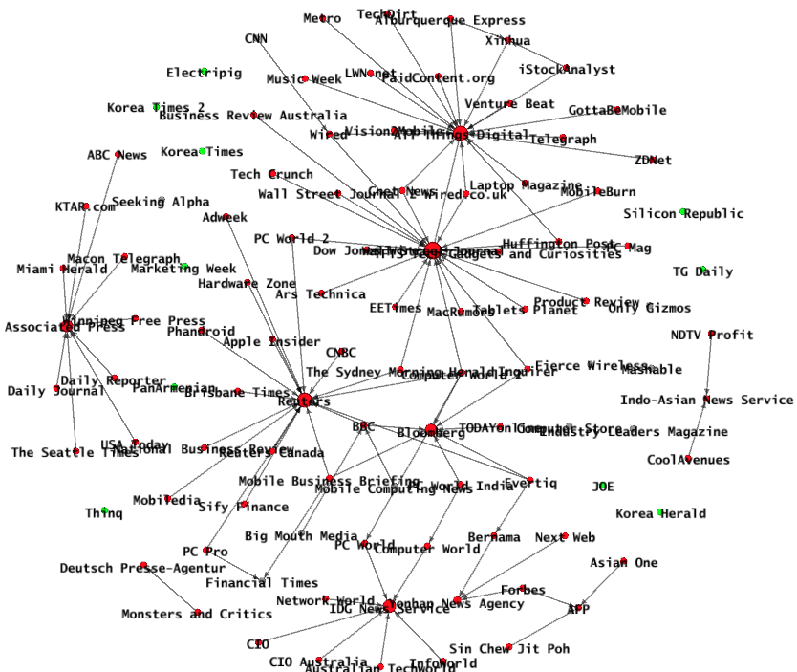
APPLE-SAMSUNG LAWSUIT
10

Slide 11
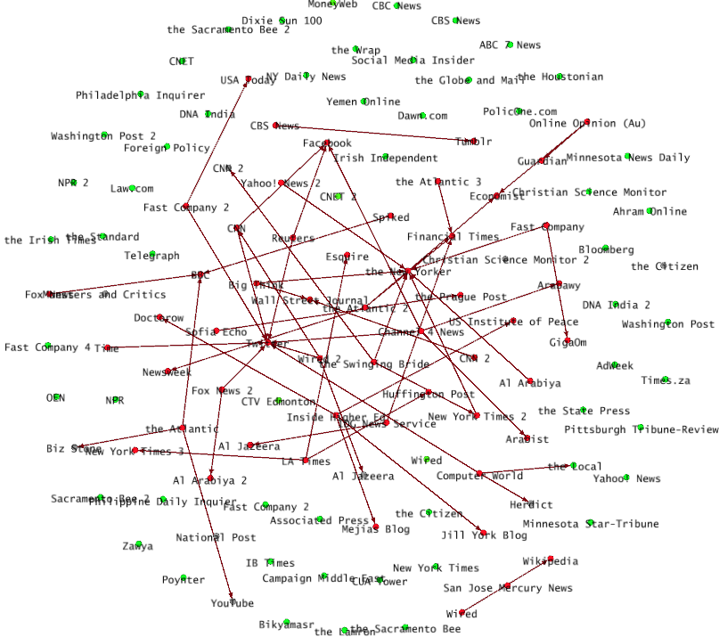
SOCIAL MEDIA -- EGYPT REVOLUTION
11

